Slide 1

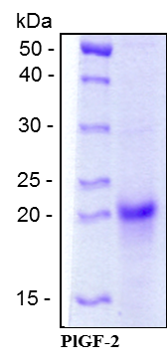
ReliaTech GmbH
Recombinant human PlGF-2
(Cat #M30-019S / -019 / -020)
Fig. 1: SDS-PAGE analysis of recombinant human PlGF-2. Sample was loaded in 15% SDS-polyacrylamide gel under reducing conditions and stained with Coomassie blue.
http://www.reliatech.de / orders@reliatech.de

